Slide 1

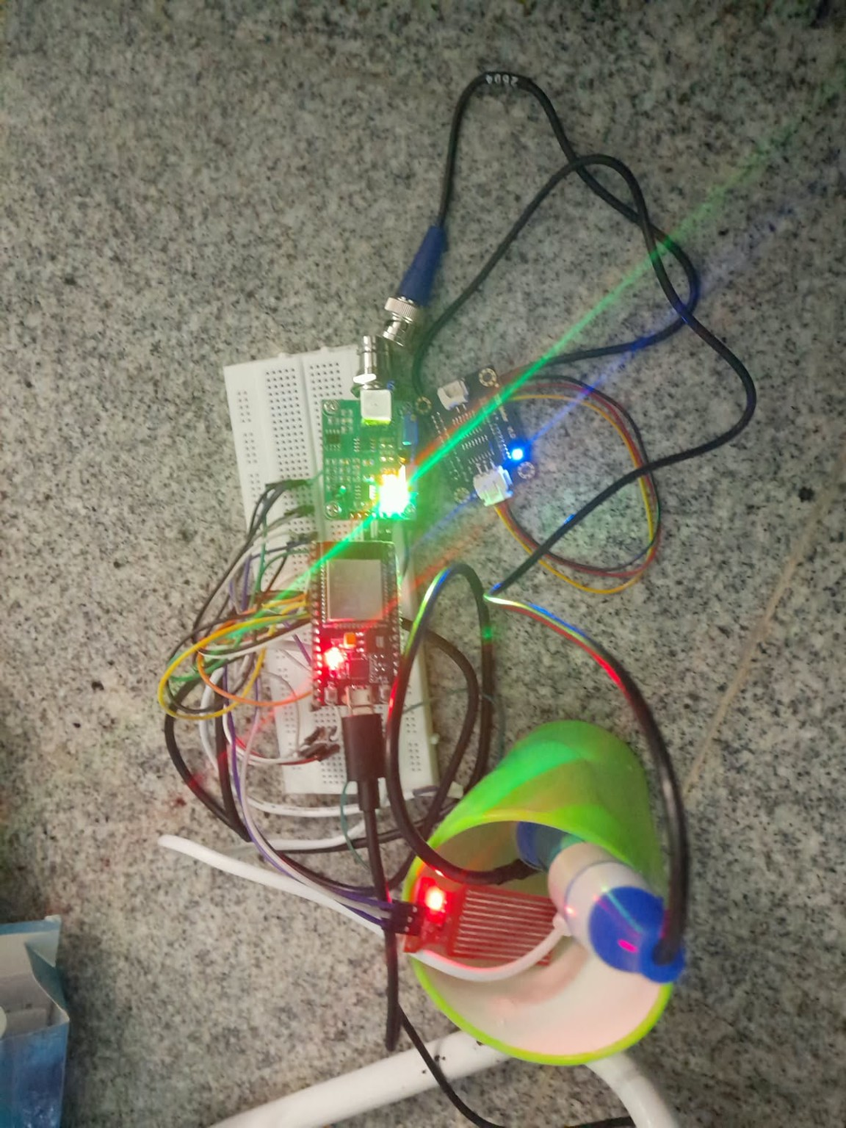
FINAL YEAR PROJECT REVIEW
Smart Aquaculture
Assistant
AI-Powered Fish Stress Prediction &
Water Quality Management System
Dharshish K.G · Haamidsha D. · Mohamed Sadhath J.
Department of AI & ML | VISTAS, Chennai | October 2026
Project Guide : Mrs .F. Benasir Begam , M.E.,(Ph.D.)
Prototype demonstration • IoT monitoring • Machine learning

Slide 2
Abstract
A low-cost prototype connecting live sensing with an understandable fish-health dashboard.
MEASURE
ASSESS
DISPLAY
ESP32 reads temperature, pH interface, TDS voltage and water-sensor values.
A rule-based layer converts current readings into Normal, At Risk or High Risk statuses.
A Streamlit dashboard presents live cards, sensor status and an overall warning.
Separate machine-learning experiment
A Random Forest model was trained on historical aquaculture data. It is evaluated separately because its features do not yet match the live sensor inputs.
Scope note: prototype decision support — not a substitute for calibrated water testing or expert aquaculture advice.
SMART AQUACULTURE ASSISTANT · 02

Slide 3
Problem statement
Why continuous monitoring and clear status feedback matter.
SPOT CHECKS MISS CHANGES
RAW VALUES ARE HARD TO INTERPRET
Manual checks happen at intervals and can miss sudden changes in pond conditions.
Farmers need simple status signals, not only isolated sensor numbers.
SENSOR READINGS NEED CARE
MODEL AND LIVE INPUTS DIFFER
Calibration, placement and electrical noise can affect water-quality measurements.
Historical ML features include dissolved oxygen and turbidity; the current live unit measures TDS voltage and water-sensor values.
SMART AQUACULTURE ASSISTANT · 03

Slide 4
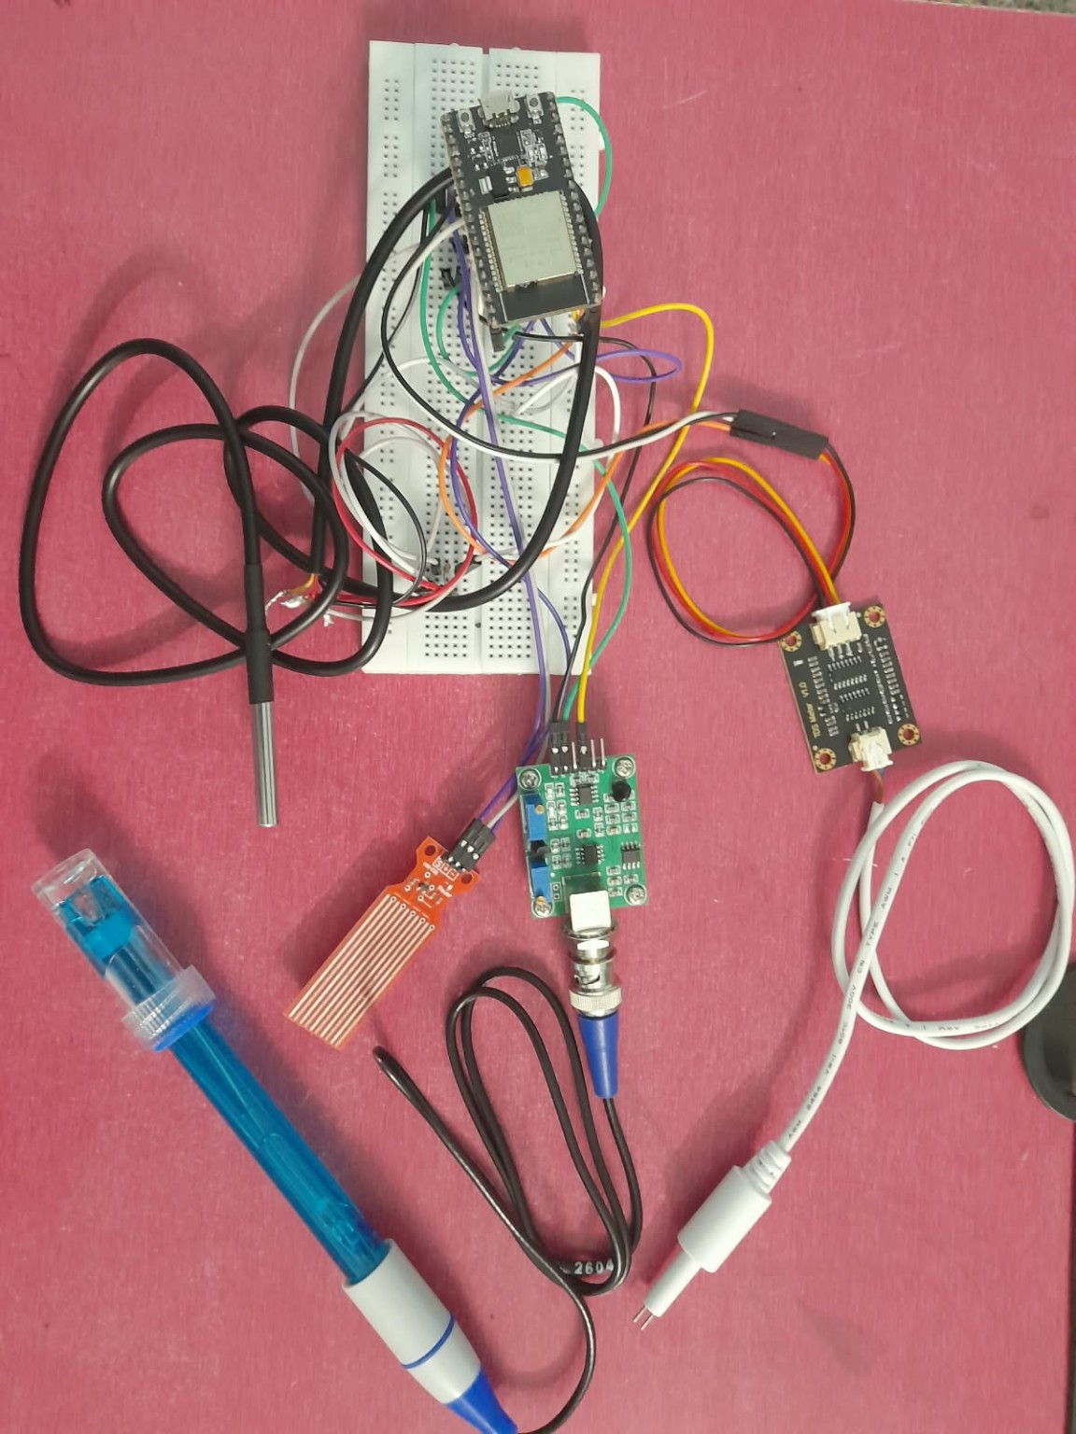
Project objectives
The project combines a working hardware demonstration with a separate ML study.
• Read live water-related measurements using an ESP32 and connected sensors.
• Stream readings to a Python application and display them in a Streamlit dashboard.
• Classify each sensor and show an overall Normal / At Risk / High Risk status.
• Train and evaluate a Random Forest classifier using a historical aquaculture dataset.
• Document wiring, software flow, limitations and practical next steps.
SMART AQUACULTURE ASSISTANT · 04

Slide 5
System architecture
Two related pipelines: live sensor monitoring and offline model training.
LIVE MONITORING PIPELINE
Sensors
ESP32
USB Serial
Streamlit
Temperature • pH
TDS voltage • water
Acquire and format
readings
Send readings
to computer
Cards • status
alerts
HISTORICAL ML PIPELINE (SEPARATE)
Dataset
Prepare
Random Forest
Evaluation
4,383 rows
28 columns
Select features
train/test split
100 estimators
Accuracy and
class metrics
Important: the historical model is not directly fed the current live sensor values because the feature sets differ.
SMART AQUACULTURE ASSISTANT · 05

Slide 6
Hardware and software components
Main elements used in the prototype.
ESP32 development board
Controller and serial communication
DS18B20
Temperature measurement
pH sensor interface
Analog pH signal; requires calibration
TDS sensor module
Analog voltage as a water-quality indicator
HW-038 water sensor
Raw water presence / level-related signal
Python + Streamlit
Serial parsing, status logic and dashboard
Random Forest (offline)
Historical dataset classification experiment
SMART AQUACULTURE ASSISTANT · 06

Slide 7
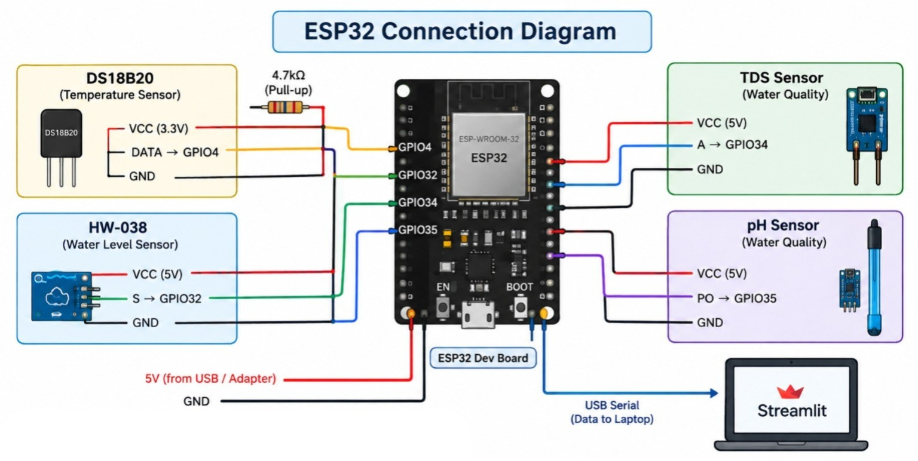
Hardware prototype and wiring
Actual prototype photographs from the project submission.
Connection diagram: shared controller, sensor inputs and USB serial output
Report note: pH and TDS interfaces require calibration before values can be interpreted quantitatively.
Assembled ESP32 and sensor modules
SMART AQUACULTURE ASSISTANT · 07

Slide 8
End-to-end workflow
From sensor acquisition to a clear dashboard warning.
01
Sense
02
Transmit
03
Parse
Sensors read water-related values.
ESP32 sends formatted data over USB serial.
Python reads and validates the incoming values.
04
Assess
05
Visualize
06
Review
Rules assign per-sensor and overall status.
Streamlit updates live cards and status banners.
User checks alerts and investigates the water conditions.
SMART AQUACULTURE ASSISTANT · 08

Slide 9
Machine-learning methodology
Random Forest experiment on a historical aquaculture dataset.
DATASET
FEATURES
MODEL
4,383 observations and 28 columns.
Temperature, dissolved oxygen, pH and turbidity.
Random Forest Classifier with 100 estimators; random_state = 42.
Reported test-split accuracy: approximately 99.89%
Interpret cautiously: this is a result on the selected historical dataset split, not proof of real-world fish-health prediction or clinical/field performance.
Integration gap: the live prototype currently provides temperature, pH, TDS voltage and water-sensor values; dissolved oxygen and turbidity are not yet measured live.
SMART AQUACULTURE ASSISTANT · 09

Slide 10
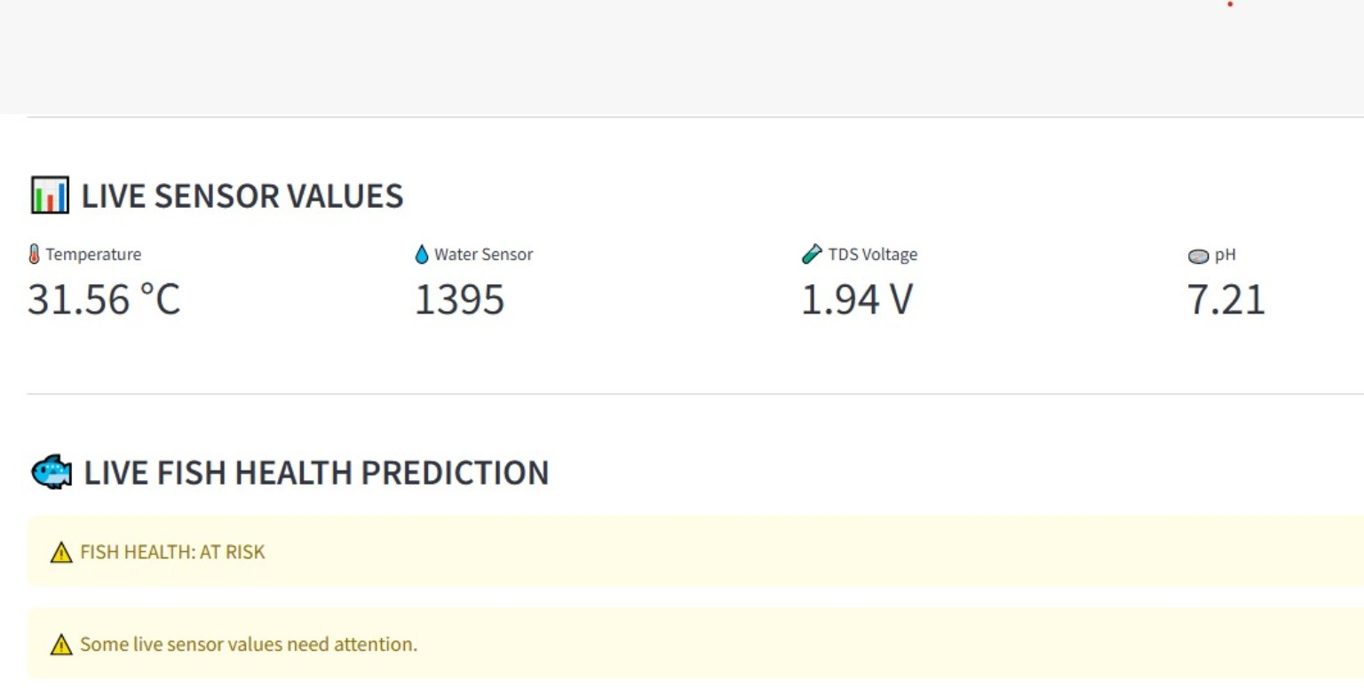
Live fish-health status logic
The current dashboard uses prototype rules to make readings easier to interpret.
NORMAL
Values fall within the configured prototype ranges.
AT RISK
One or more readings need attention.
HIGH RISK
Multiple conditions cross configured thresholds.
These labels are demonstration outputs. Thresholds and sensor calibration must be validated for the species, life stage and local conditions.
SMART AQUACULTURE ASSISTANT · 10

Slide 11
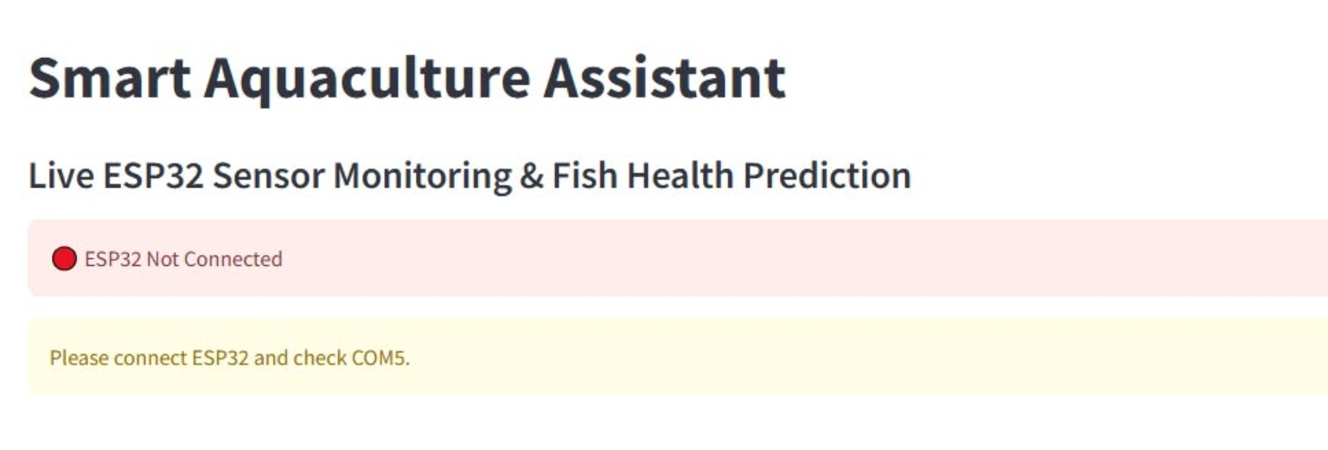
Dashboard: live overview
Actual Streamlit dashboard capture from the prototype.
LIVE CARDS
Temperature, pH, TDS voltage and water sensor.
STATUS BANNER
Overall state shown with clear color-coded feedback.
SENSOR STATUS
Individual sensor status helps locate which reading needs attention.
SMART AQUACULTURE ASSISTANT · 11

Slide 12
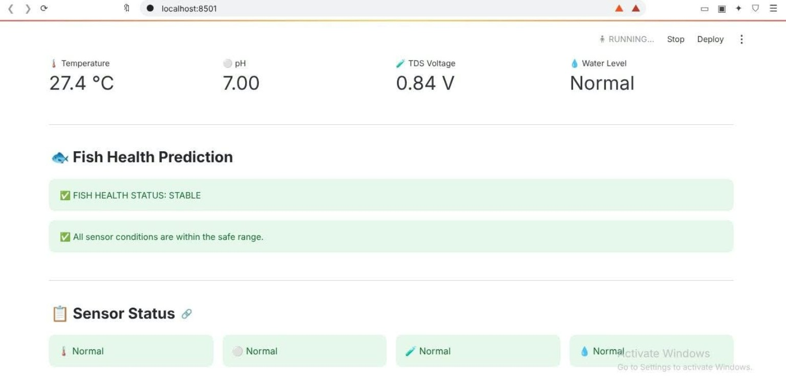
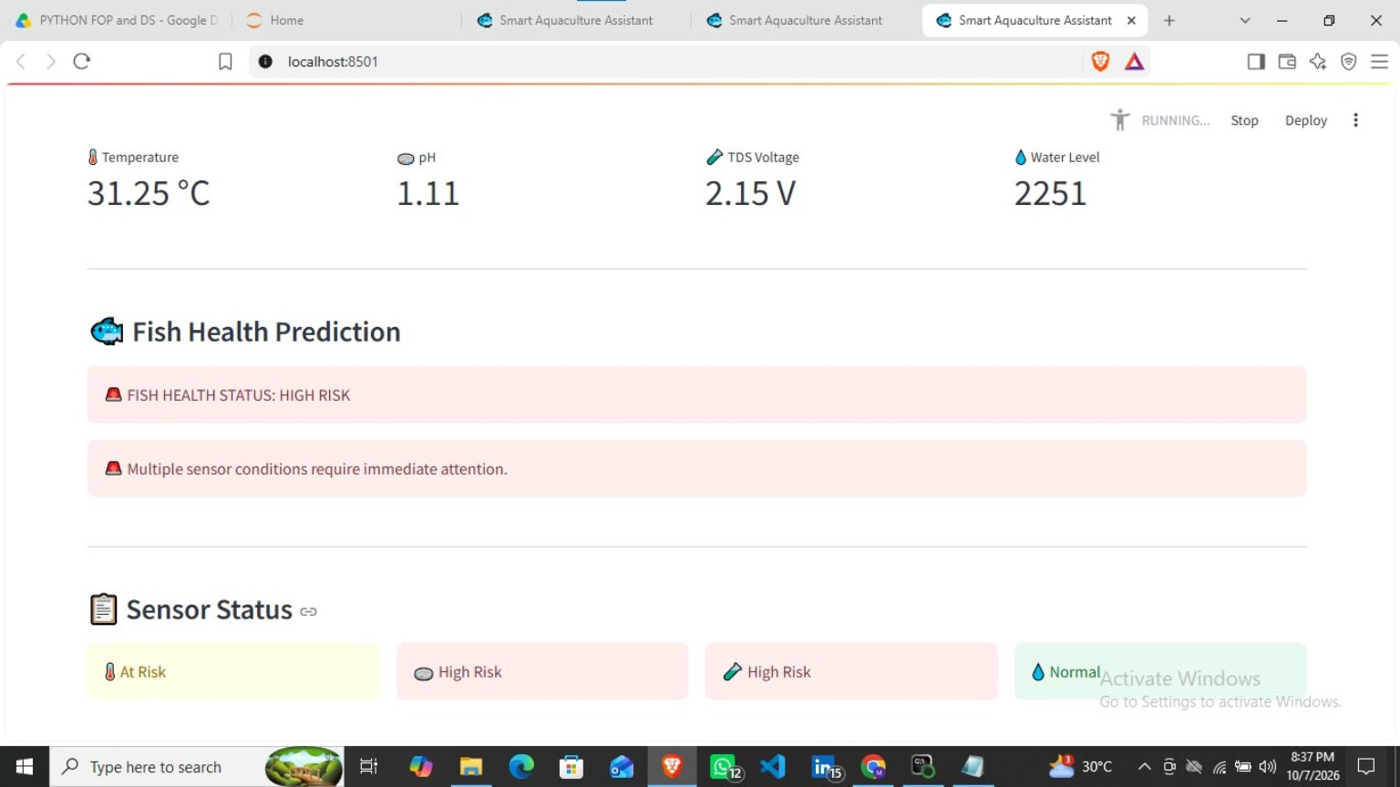
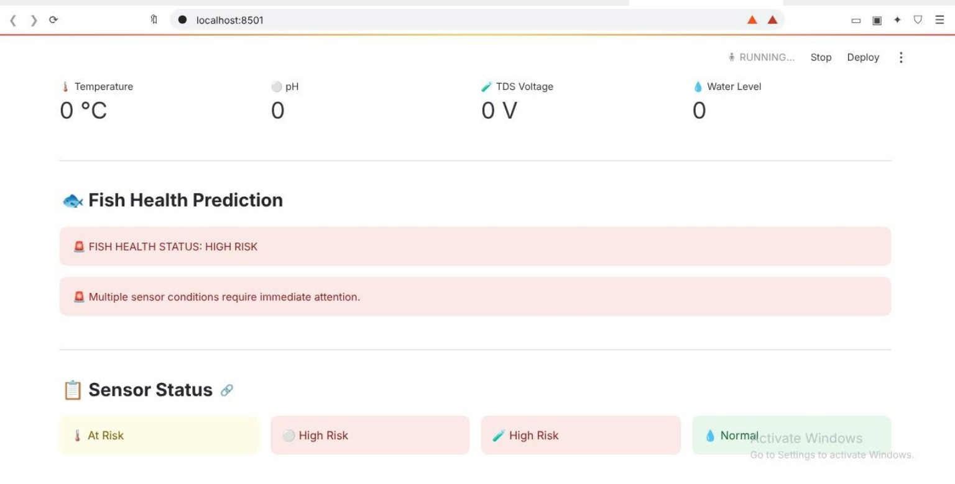
Dashboard: stable, at-risk and high-risk examples
Example screenshots from live demonstration sessions.
STABLE EXAMPLE
HIGH-RISK EXAMPLE
CONNECTION ISSUE
Screenshots illustrate the interface behavior. A disconnected device must be treated as missing data, not as safe water.
SMART AQUACULTURE ASSISTANT · 12

Slide 13
Testing and validation status
Observed prototype behavior and remaining verification work.
TEMPERATURE
TDS VOLTAGE
WATER SENSOR
Realistic DS18B20 readings observed during bench testing.
Analog voltage readings observed; calibrated ppm is not claimed.
Raw readings changed during testing; interpretation depends on setup.
Known validation gaps
The pH interface needs additional calibration. No dissolved-oxygen or turbidity sensor is currently part of the live prototype.
Do not present the ML accuracy as live hardware accuracy. Further repeated tests, calibration records and field trials are needed.
SMART AQUACULTURE ASSISTANT · 13

Slide 14
Limitations
What the current prototype does — and does not — establish.
CURRENT LIMITATIONS
RESPONSIBLE INTERPRETATION
• pH and TDS readings need calibration
• Live system lacks dissolved oxygen and turbidity
• Sensor values depend on placement and electrical stability
• ML dataset and live sensor inputs are not yet integrated
• No large-scale pond trial is documented
• Dashboard status is an early warning aid
• Historical model performance is dataset-specific
• Thresholds should be species- and context-aware
• Confirm abnormal readings with calibrated instruments
• Human observation and expert judgment remain essential
SMART AQUACULTURE ASSISTANT · 14

Slide 15
Future enhancements
A practical path from classroom prototype to a more reliable monitoring system.
CALIBRATE
EXPAND SENSORS
Calibrate pH and TDS; document reference measurements.
Add dissolved oxygen and turbidity sensing to match ML features.
COLLECT DATA
VALIDATE MODEL
Build synchronized live records with labels and pond context.
Use leakage-safe splits, class metrics and independent field data.
IMPROVE DEPLOYMENT
FIELD PILOT
Add robust enclosure, connectivity, logging and offline recovery.
Evaluate with aquaculture experts under controlled conditions.
SMART AQUACULTURE ASSISTANT · 15

Slide 16
Conclusion
A practical foundation for clearer water-quality monitoring
The project demonstrates an ESP32-based sensor prototype, a live Streamlit dashboard, rule-based status feedback and a separate Random Forest experiment on historical aquaculture data.
LIVE
ACTIONABLE
NEXT STEP
Sensor values visible in one dashboard
Color-coded status makes attention areas easier to spot
Calibration and field validation before operational use
Thank you · Questions
Dharshish K.G · Haamidsha D. · Mohamed Sadhath J. | VISTAS

